Slide 1
CASA0011: Agent-Based Modelling
Dr Sarah WISE
Dr Thomas OLÉRON EVANS
s.wise@ucl.ac.uk
thomas.evans.11@ucl.ac.uk
Moodle password: ABM20
Centre for Advanced
Spatial Analysis,
90 Tottenham Court Road

Slide 2
LECTURE 7B Investigating Models

Slide 3
OBJECTIVES 1. Consider a case study on investigating, visualising and measuring model outcomes.

Slide 4
Course Objectives
You should...
1. understand the principles of
agent-based modelling (ABM).
2. be able to describe the type and range of systems to which ABM can be profitably and appropriately applied.
3. be able to conceptualise and model
urban systems with complex dynamics.
4. show evidence of being able to translate your
understanding into the practical methodology of modelling

Slide 5
Example – 1D Single Species B Models

Slide 6
Example – 1D Single Species B Models
E
E
E
S
SET UP
Ring of cells
Two states: S, E
Each iteration: Select a cell at random; Select a neighbour at random;
Apply the transition rule
S
S
E
S
E
E
E
E
S
E
E
E
E
S
S
S
E
E
E
E

Slide 7
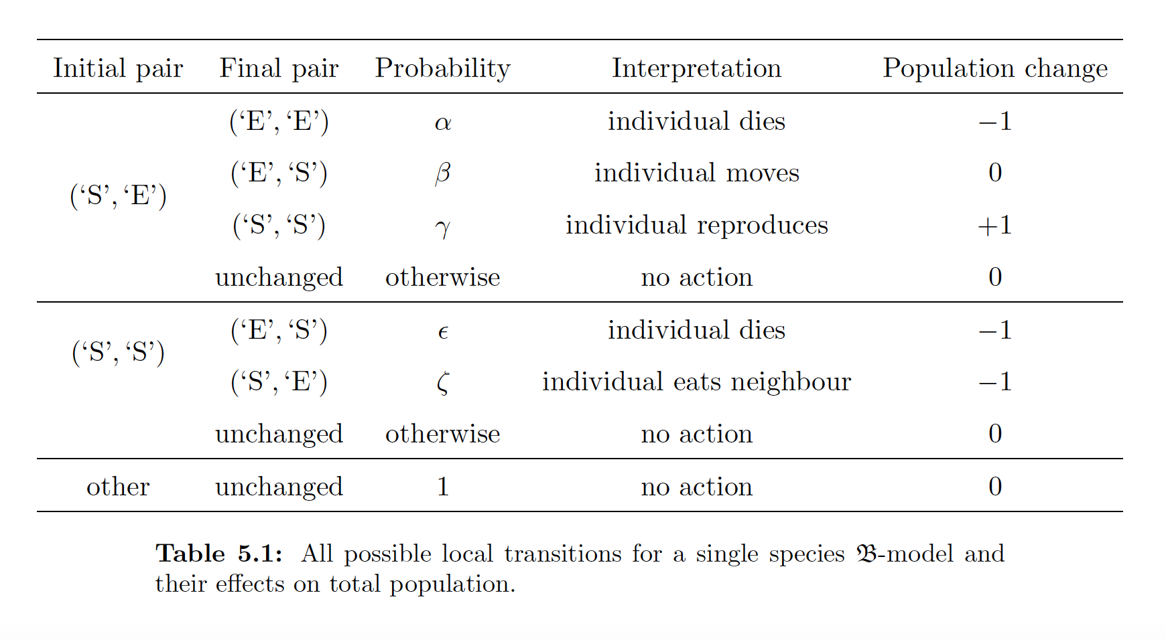
Example – Single Species B Models

Slide 8
Example – Single Species B Models
η = ε + ζ

Slide 9
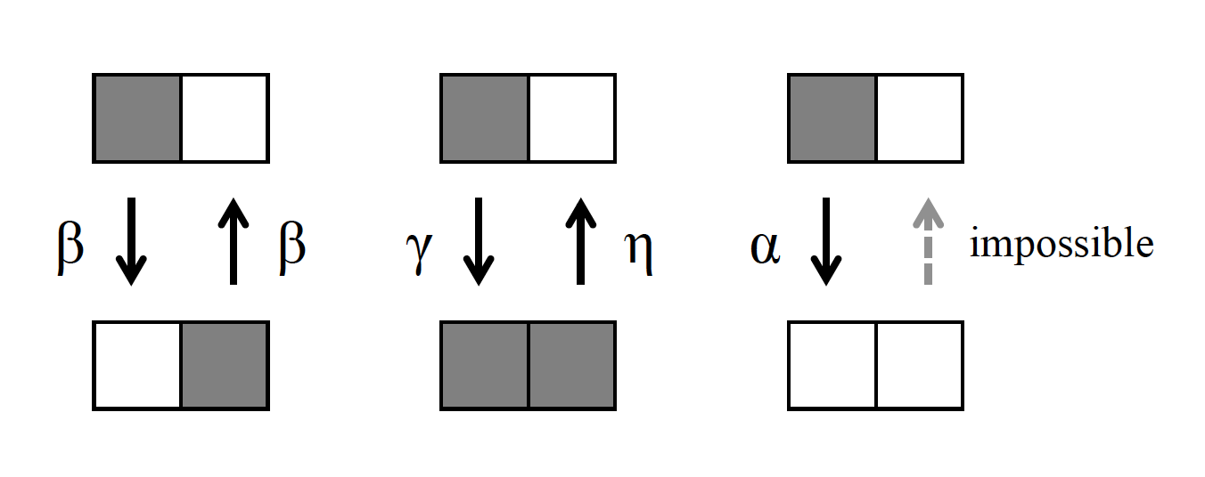
Example – Single Species B Models

Slide 10
Example – Single Species B Models
OBJECTIVE
Understand the complete range
of behaviours of the model

Slide 11
Example – Single Species B Models
Parameter Space: Probabilities α, β, γ, η

Slide 12
Example – Single Species B Models
Parameter Space:
Parameters α, β, γ (η = 0)
Parameters α*, β*, γ* (η ≠ 0)

Slide 13
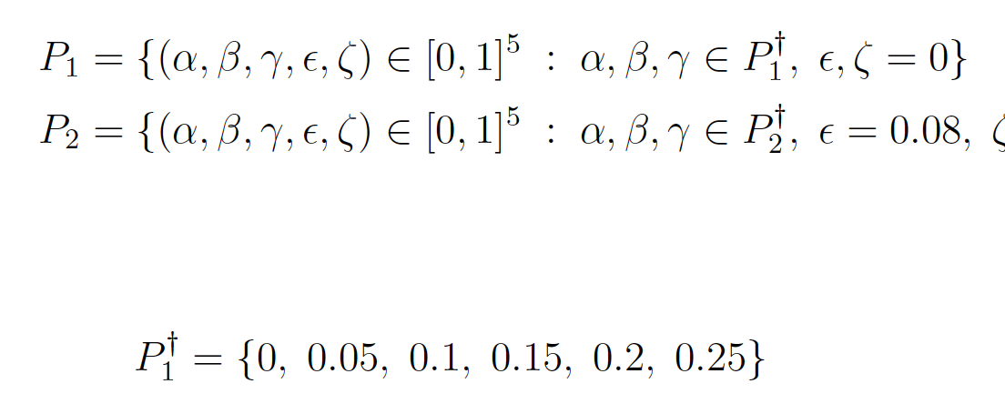
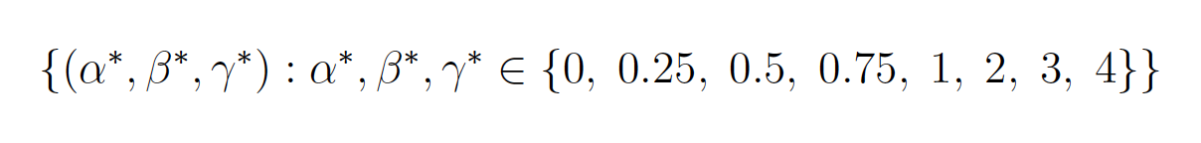
Example – Single Species B Models
Exploratory Systematic Search
η = 0
η ≠ 0
1000 cells, 1.6 million iterations, 10 repetitions
Complete state recorded every 3200 iterations

Slide 14
Example – Single Species B Models
Approach 1 – Visualisation

Slide 15
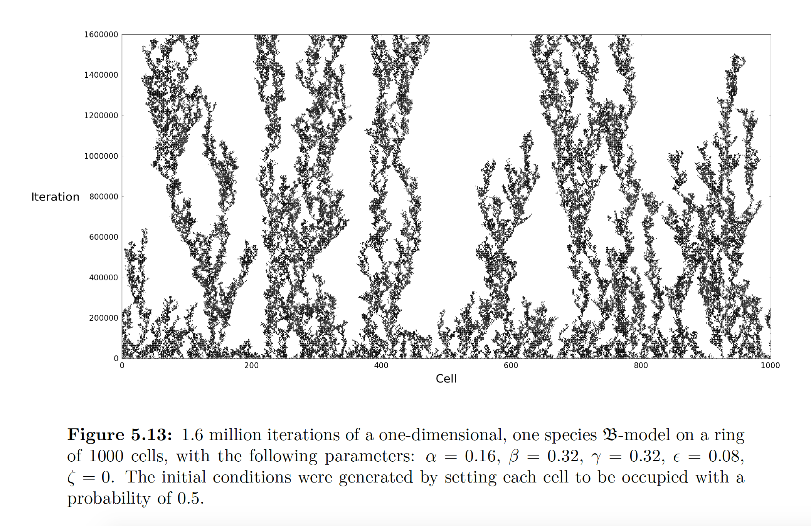
Example – Single Species B Models
Approach 1 – Full System Visualisation

Slide 16
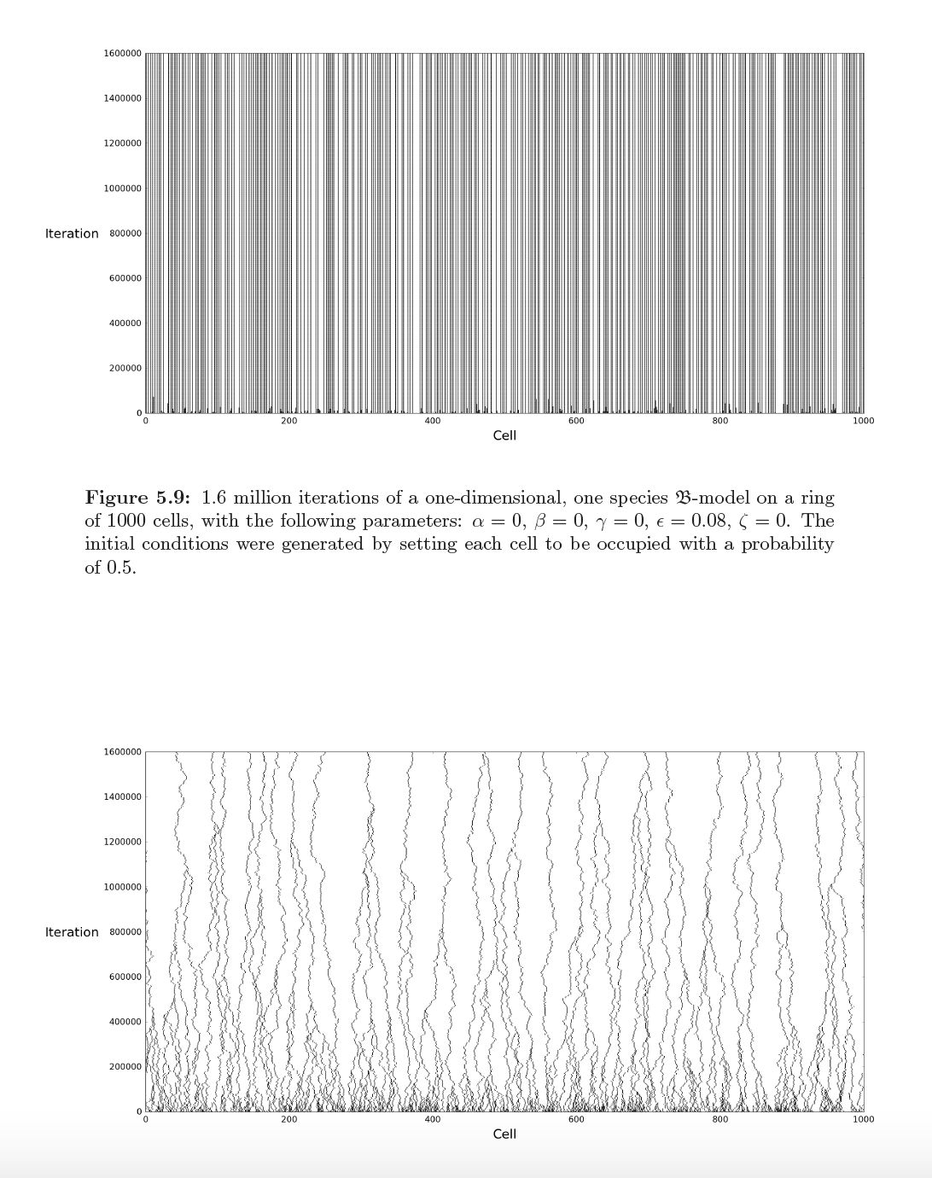
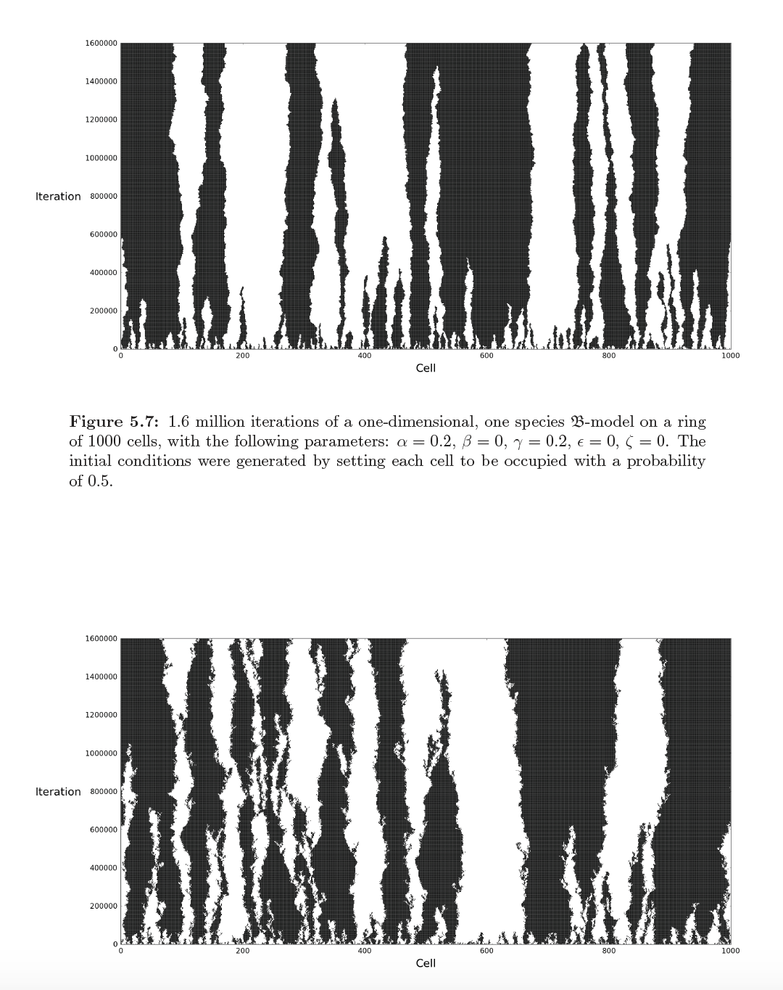
Example – Single Species B Models
Approach 1 – Full System Visualisation
Allowed me to catalogue different behavioural
types and associate them with parameter values

Slide 17
Example – Single Species B Models
Approach 1I – Studying a single metric
Population Density

Slide 18
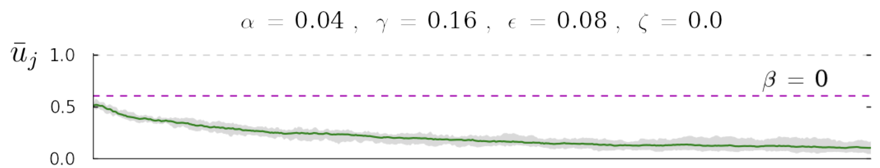
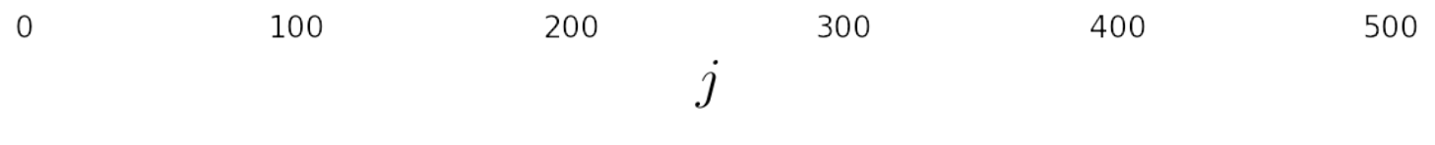
Example – Single Species B Models
Approach 1I – Studying a single metric
Population Density

Slide 19
Example – Single Species B Models
Approach 1I – Studying a single metric
Population Density
(Was 10 repetitions sufficient?)

Slide 20
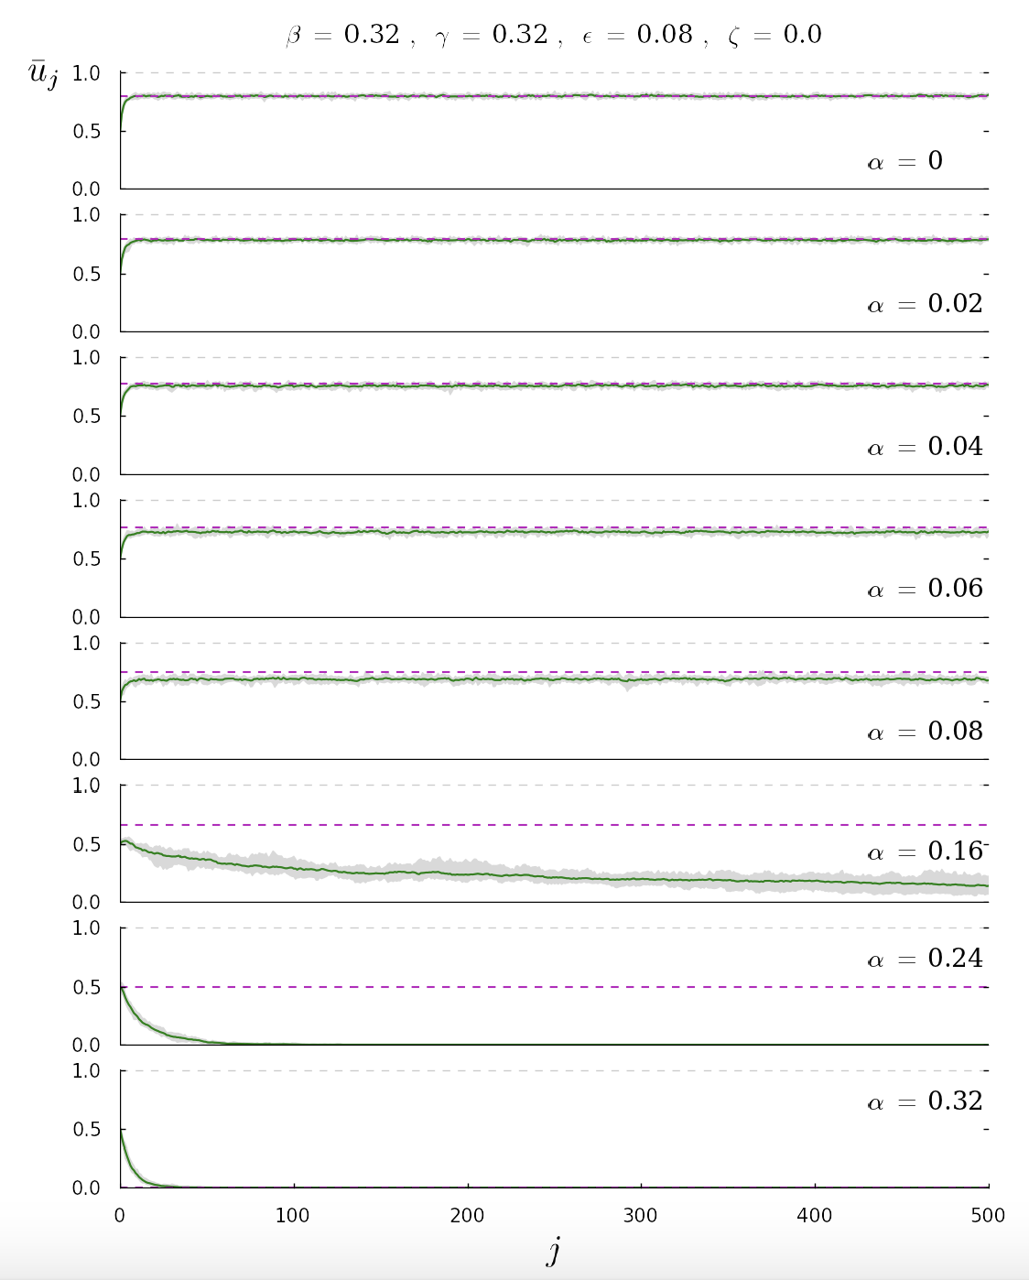
Example – Single Species B Models
Approach 1I
Studying a single metric
Vary one variable, while holding others constant

Slide 21
Example – Single Species B Models
Approach 1I
Studying a single metric
Vary one variable, while holding others constant
‘Warm-Up’
Period

Slide 22
Example – Single Species B Models
Approach 1I
Studying a single metric
Vary one variable, while holding others constant
Suggested a new metric:
Long-term equilibrium population density

Slide 23
Example – Single Species B Models
Approach III – Mapping the Parameter Space

Slide 24
Example – Single Species B Models
Approach III – Mapping the Parameter Space
Challenge: 3 or 4 dimensions
Complications: Did the population settle down?
Additional Information: Theoretical Equilibria
How to visualise?

Slide 25
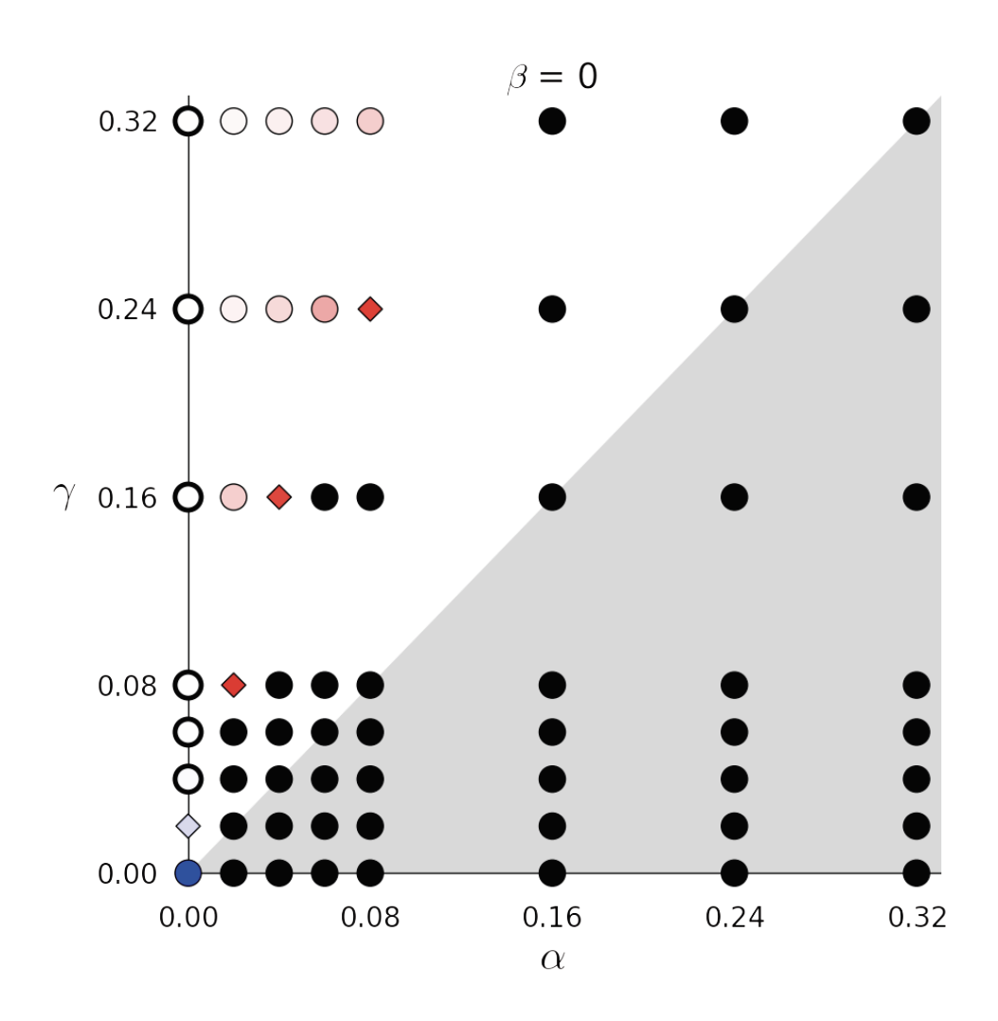
Example – Single Species B Models
Approach III – Mapping the Parameter Space
( η ≠ 0 )

Slide 26
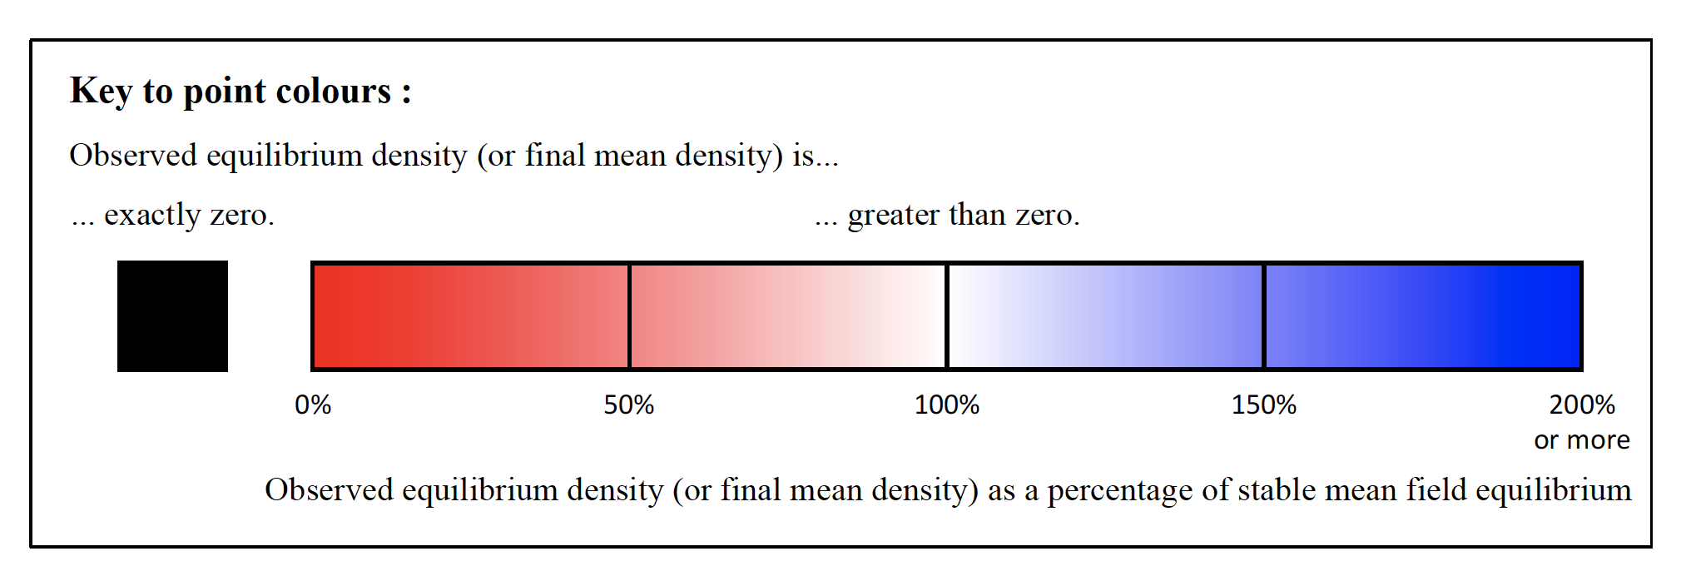
Example – Single Species B Models
Approach III – Mapping the Parameter Space

Slide 27
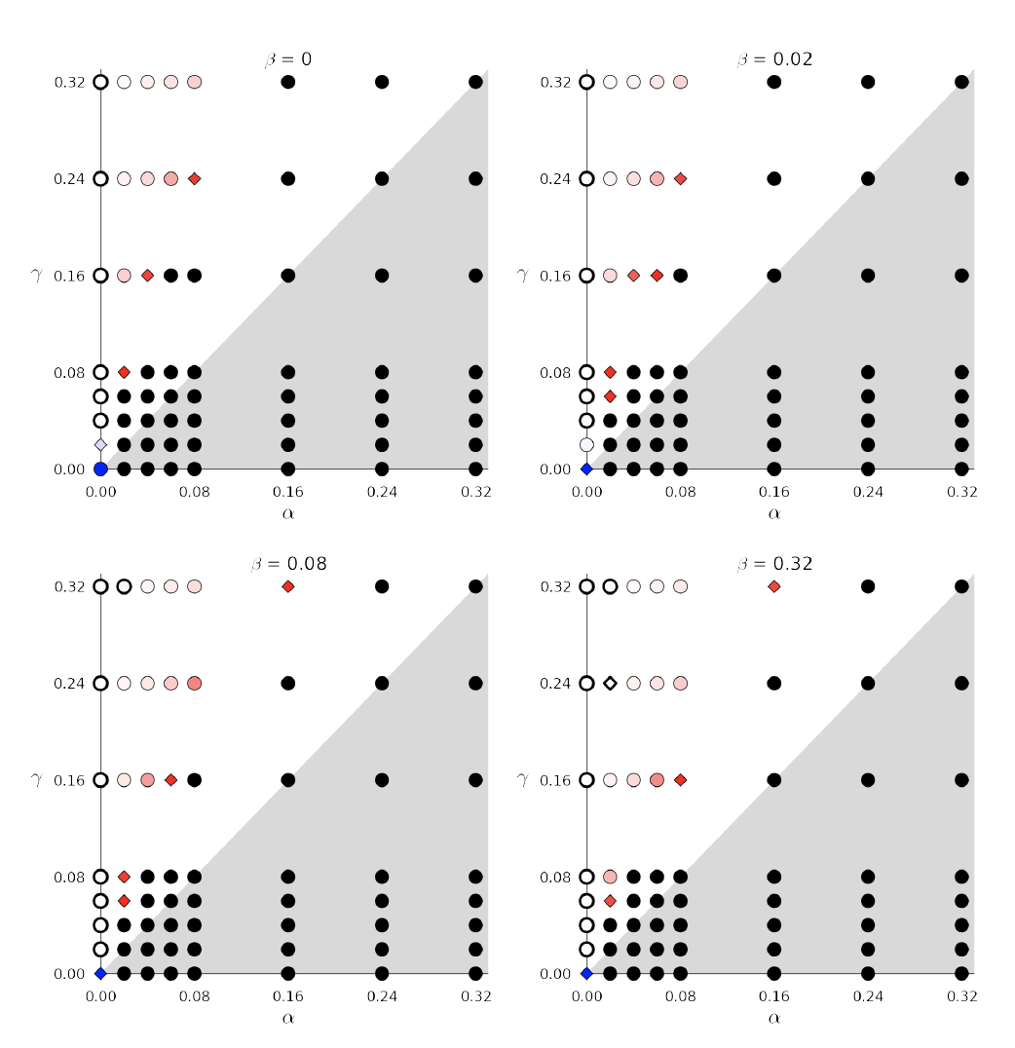
Example – Single Species B Models
Approach III – Mapping the Parameter Space
( η ≠ 0 )

Slide 28
Example – Single Species B Models
Approach IV+ – More complicated metrics

Slide 29
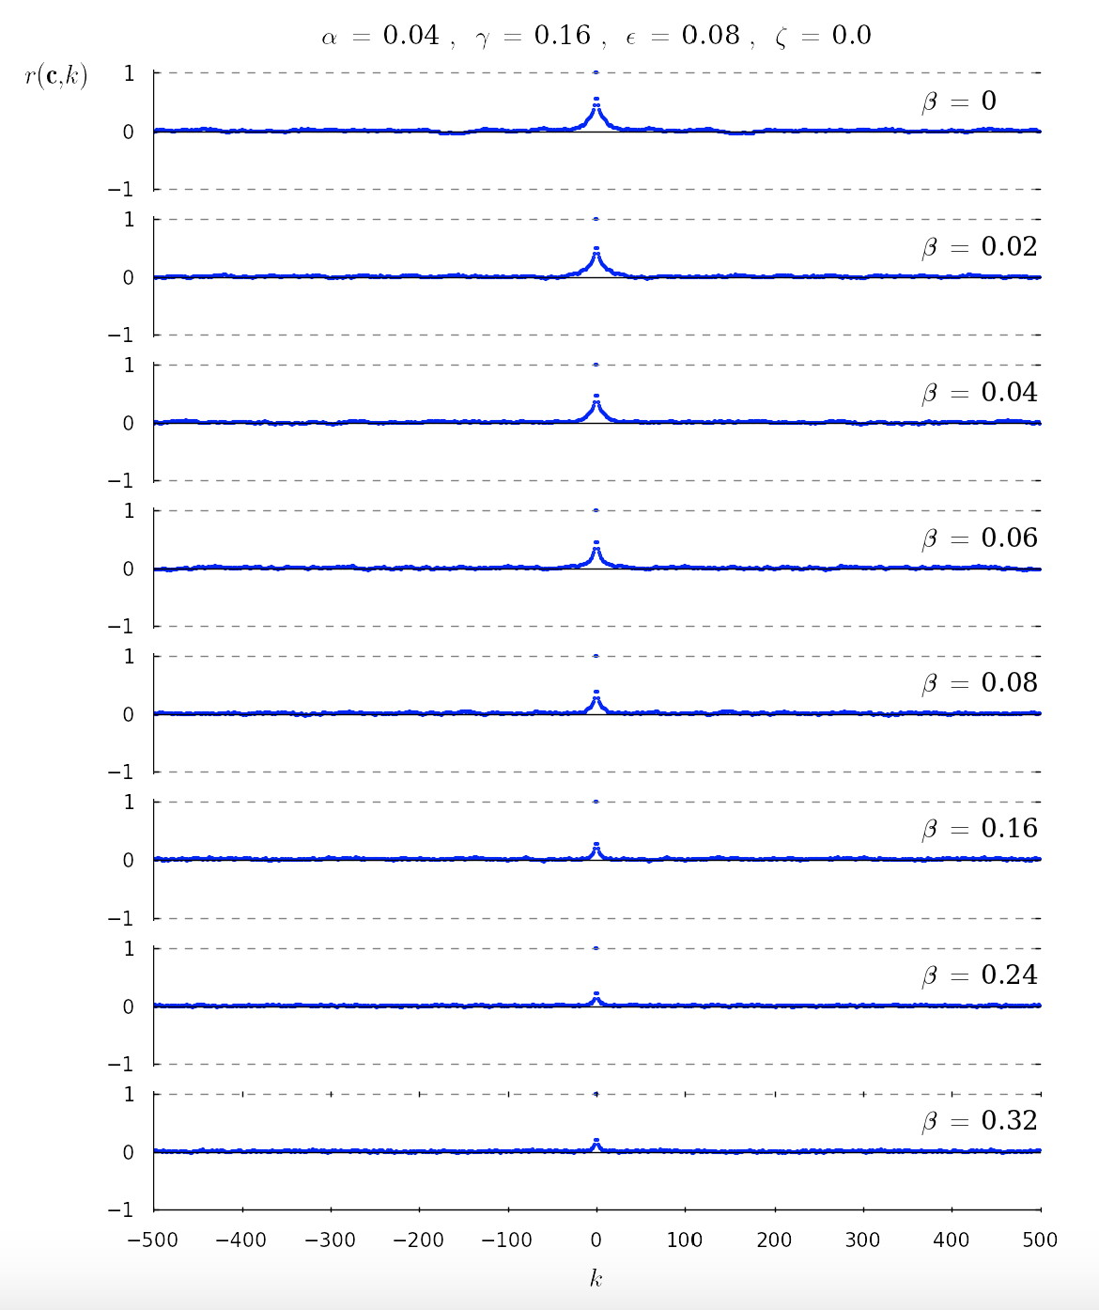
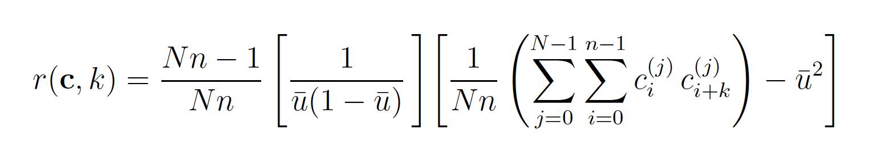
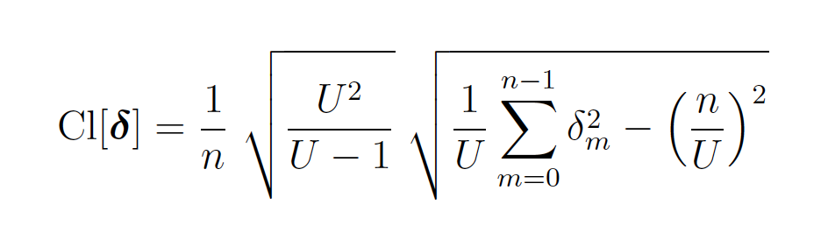
Example – Single Species B Models
Approach IV+ – More complicated metrics
Empirical Autocorrelation
Agent Clumping

Slide 30
Example – Single Species B Models
Approach IV+ – Alternative Visualisations

Slide 31
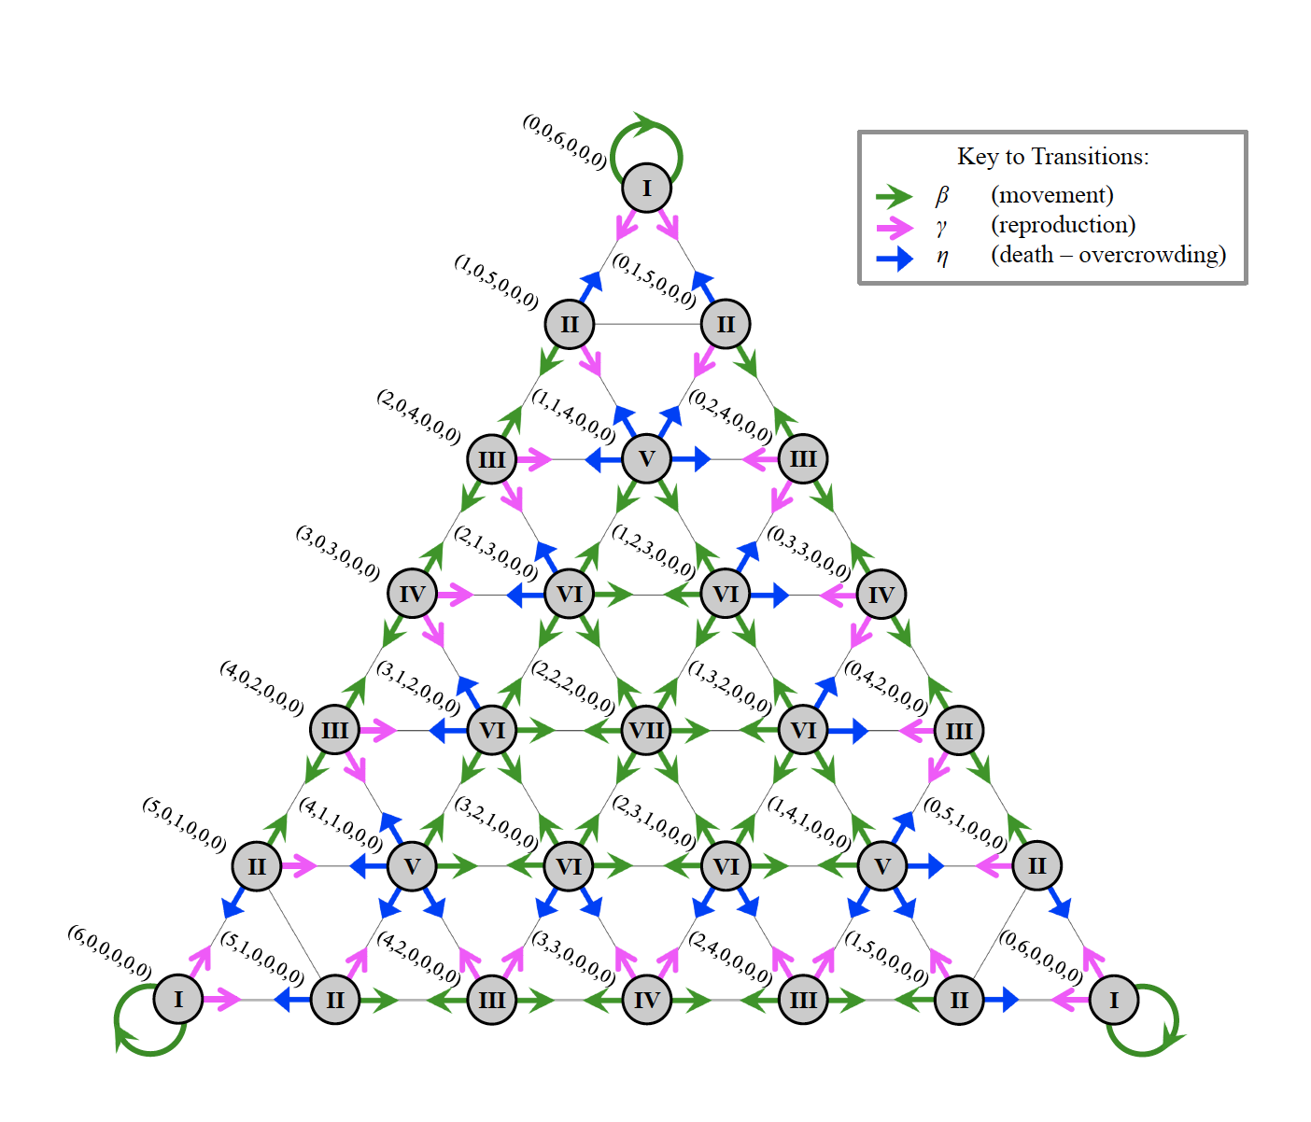
Example – Single Species B Models
Approach IV+ – Alternative Visualisations

Slide 32
OBJECTIVES 1. Consider a case study on investigating, visualising and measuring model outcomes.

